Slide 1


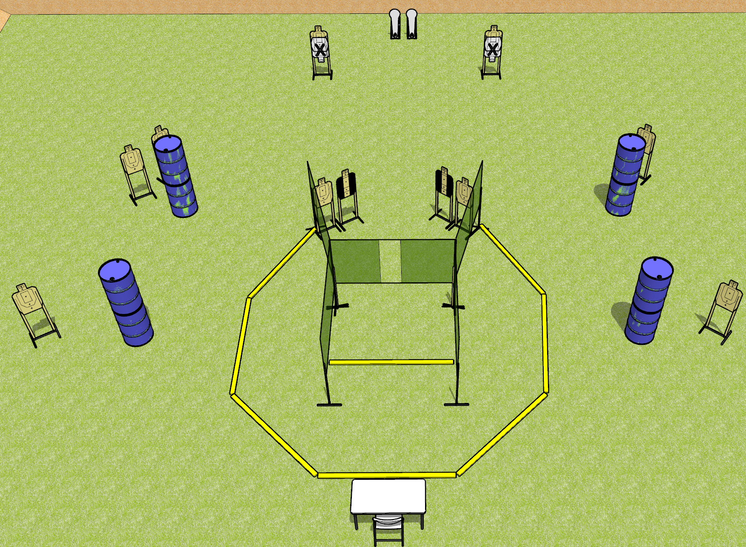
 | Dothan Gun Club – USPSA Match Boop Course Designer : Drew Coleman
START POSITION : Seated in chair with back against chair. Hands flat on knees.
GUN READY CONDITION : Firearm unloaded on table, trigger guard on a mark. First magazine to be used for stage placed on table on other mark. |  | SCORING: Comstock, 24 rounds TARGETS: 11 paper, 2 Steel SCORED HITS: Best 2 on paper, steel until down START-STOP: Audible, last shot RULES:
STAGE PROCEDURE: Engage targets as they become available from within the fault lines.

Slide 2
Boop
Written Stage Briefing
Boop is a 24 round, 120 point, Comstock field course. There are eleven USPSA targets and two colt poppers. The best two hits on paper will score, and steel must fall to score. The start signal is audible.
Start position is seated in chair, back against chair. Hands flat on knees. Firearm is unloaded with trigger guard on mark. First magazine to be used in stage is placed on other mark.
On start signal, engage targets as they become available from within the shooting area.

Slide 3
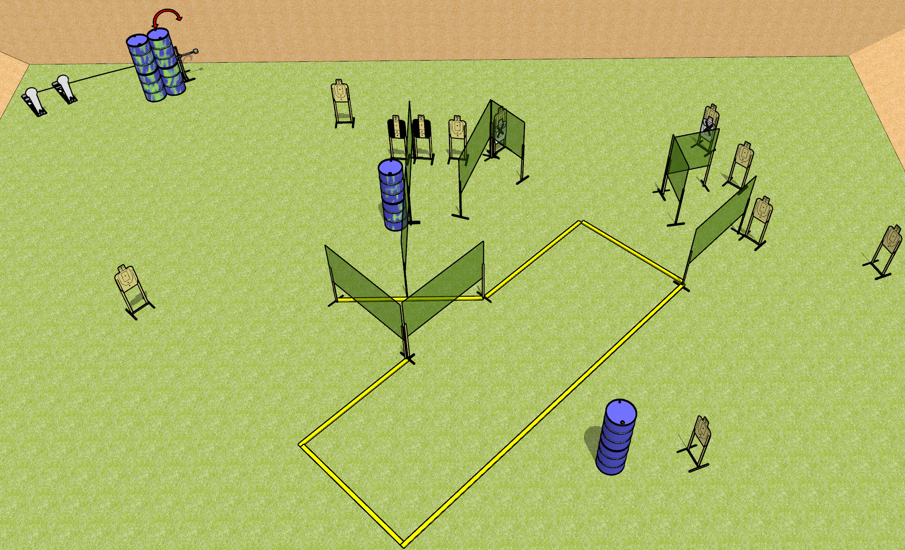
 | Dothan Gun Club – USPSA Match Footwork Course Designer : Drew Coleman
START POSITION : Anywhere inside the shooting area, wrists below belt
GUN READY CONDITION : Pistol loaded and holstered. PCC loaded, held with both hands, shouldered, safety on, pointed at orange cone. |  | SCORING: Comstock, 26 rounds TARGETS: 12 paper, 2 Steel SCORED HITS: Best 2 on paper, steel until down START-STOP: Audible, last shot RULES:
STAGE PROCEDURE: Engage targets as they become available from within the fault lines.

Slide 4
Footwork
Written Stage Briefing
Footwork is a 26 round, 130 point, Comstock field course. There are twelve USPSA targets and two colt poppers. The best two hits on paper will score, and steel must fall to score. The start signal is audible.
The swinger is activated by either colt popper. Please check the activator prior to walkthrough and set it the same way every time.
Handgun start position is anywhere inside the shooting area, wrists below belt. Handgun is loaded and holstered.
PCC start position is anywhere inside the shooting area. Loaded carbine is held with both hands, stock on belt, safety on.
On start signal, engage targets as they become available from within the shooting area.

Slide 5
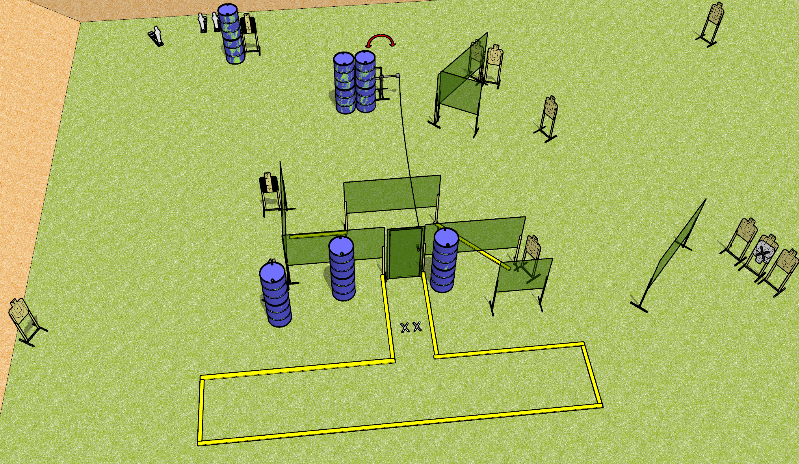
 | Dothan Gun Club – USPSA Match Mind the Wire Course Designer : Drew Coleman
START POSITION : Standing with both feet on X’s toes pointed towards door, wrists below belt
GUN READY CONDITION : Pistol loaded and holstered. PCC loaded, held with both hands, shouldered, safety on, pointed at door |  | SCORING: Comstock, 27 rounds TARGETS: 12 paper, 3 Steel SCORED HITS: Best 2 on paper, steel until down START-STOP: Audible, last shot RULES: Setup notes – use a hard cover for the swinger (deal with it Dan!)
STAGE PROCEDURE: Engage targets as they become available from within the fault lines.

Slide 6
Mind the Wire
Written Stage Briefing
Mind the Wire is a 27 round, 135 point, Comstock field course. There are twelve USPSA targets and three mini poppers. The best two hits on paper will score, and steel must fall to score. The start signal is audible.
The swinger is activated by the door (stomp box if present). Please check the activator prior to walkthrough and set it up the same way for every shooter.
Handgun start position is both feet on X’s, toes pointed at door, wrists below belt. Handgun is loaded and holstered.
PCC start position is both feet on X’s, toes and muzzle pointed at door. Loaded carbine is held with both hands, shouldered, safety on.
On start signal, engage targets as they become available from within the shooting area.

Slide 7
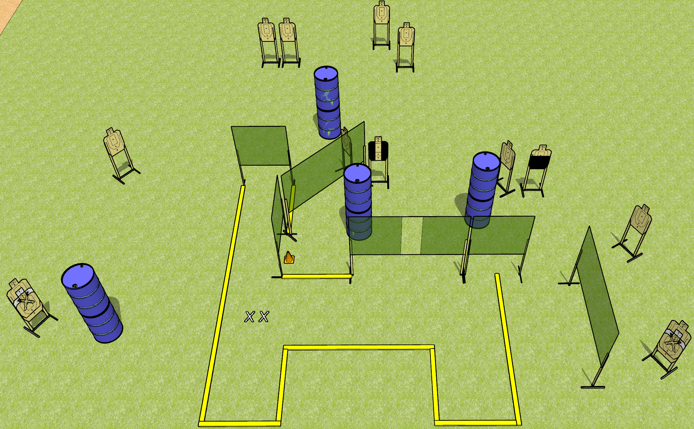
 | Dothan Gun Club – USPSA Match Baby Huey Plus Course Designer : Patrick Free
START POSITION : Standing with both feet on X’s, wrists below belt
GUN READY CONDITION : Pistol loaded and holstered. PCC loaded, held with both hands, shouldered, safety on, pointed at orange cone. |  | SCORING: Comstock, 28 rounds TARGETS: 14 paper, 0 Steel SCORED HITS: Best 2 on paper, steel until down START-STOP: Audible, last shot RULES:
STAGE PROCEDURE: Engage targets as they become available from within the fault lines.

Slide 8
Baby Huey Plus
Written Stage Briefing
Baby Huey Plus is a 28 round, 140 point, Comstock field course. There are fourteen USPSA targets. The best two hits on paper will score. The start signal is audible.
Handgun start position is both feet on X’s, wrists below belt. Handgun is loaded and holstered.
PCC start position is both feet on X’s, muzzle pointed at orange cone. Loaded carbine is held with both hands, safety on, shouldered.
On start signal, engage targets as they become available from within the shooting area.

Slide 9
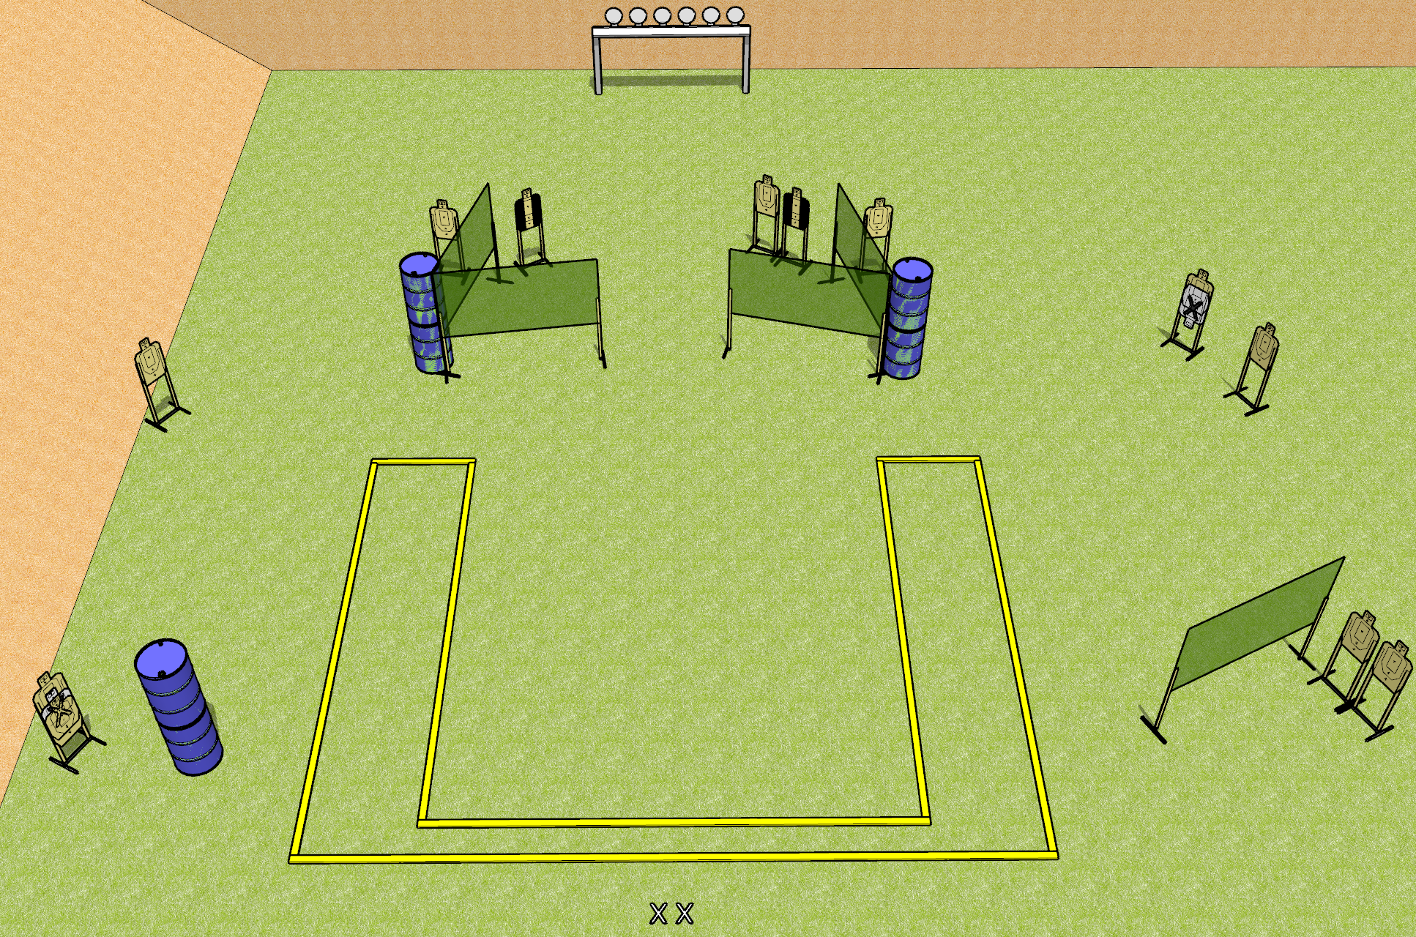
 | Dothan Gun Club – USPSA Match Upside Down Course Designer : Patricia Free
START POSITION : Standing with both feet on X’s, wrists above shoulders, facing uprange
GUN READY CONDITION : Pistol unloaded and holstered. PCC unloaded, stock on belt, facing downrange. |  | SCORING: Comstock, 30 rounds TARGETS: 12 paper, 6 Steel SCORED HITS: Best 2 on paper, steel until down START-STOP: Audible, last shot RULES: Setup note – post all paper targets upside down.
STAGE PROCEDURE: Engage targets as they become available from within the fault lines.

Slide 10
Upside Down
Written Stage Briefing
Upside Down is a 30 round, 150 point, Comstock field course. There are twelve USPSA targets and six falling plates. The best two hits on paper will score, and steel must fall to score. The start signal is audible.
Handgun start position is both feet on X’s, wrists above shoulders. Handgun is unloaded and holstered.
PCC start position is both feet on X’s. Unloaded carbine is held with both hands, stock on belt.
On start signal, engage targets as they become available from within the shooting area.

Slide 11
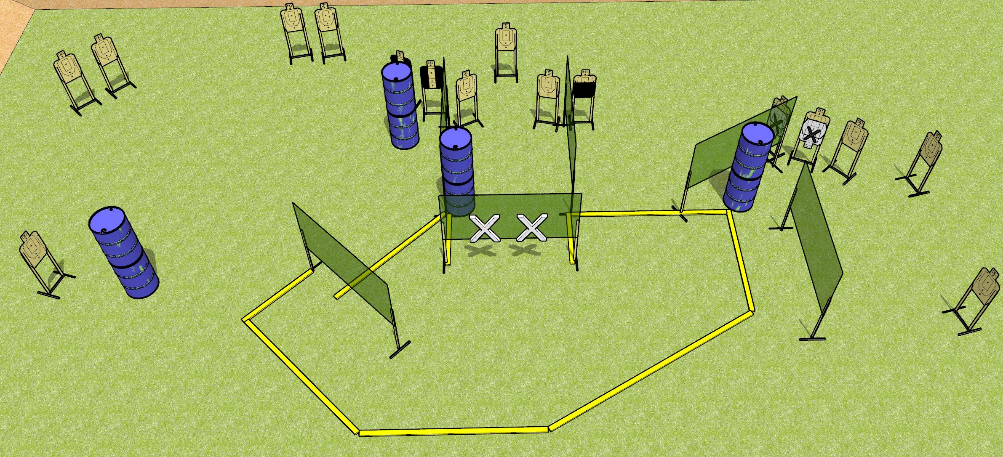
 | Dothan Gun Club – USPSA Match Shortcuts Course Designer : Drew Coleman
START POSITION : Standing with both hands touching wall marked with X’s on diagram (touching anywhere).
GUN READY CONDITION : Pistol loaded and holstered. PCC loaded, held with both hands, shouldered, safety on, muzzle touching the wall marked on the diagram. |  | SCORING: Comstock, 32 rounds TARGETS: 16 paper, 0 Steel SCORED HITS: Best 2 on paper, steel until down START-STOP: Audible, last shot RULES:
STAGE PROCEDURE: Engage targets as they become available from within the fault lines.

Slide 12
Shortcuts
Written Stage Briefing
Shortcuts is a 32 round, 160 point, Comstock field course. There are sixteen USPSA targets. The best two hits on paper will score. The start signal is audible.
Handgun start position is standing with both hands touching the wall marked on the diagram. Pistol is loaded and holstered.
PCC start position is standing with muzzle touching the wall marked on the diagram. Loaded carbine is held with both hands, safety on.
On start signal, engage targets as they become available from within the shooting area

